Slide 1

Rules Designer Training Course
Marlborough Stirling Canada Sept. 2004

Slide 2
Notices
© Marlborough Stirling Canada 2004
Copyright in this work is vested in Marlborough Stirling Canada (Marlborough Stirling). This work may form part of a proposal by Marlborough Stirling and may not be used for any purpose other than the furtherance of such proposal. No part of this document nor the information contained herein may be reproduced, stored in a retrieval system or transmitted in any way or by any means including photocopying or recording, nor may this document or any part or parts hereof nor the information contained herein be released to any third party without the prior written consent of Marlborough Stirling, application for which should be addressed to the Company Secretary at Marlborough Stirling.

Slide 3
Rule Designer
Course Modules
  Course Context
  Data Types
    Combo Groups
    Global Parameters
    Parameter Matrices
  Rule Elements
  Rule Construction
  Working With Existing Rules
  Exercises

Slide 4
Rule Designer
Course Modules
  Course Context
  Data Types
    Combo Groups
    Global Parameters
    Parameter Matrices
  Rule Elements
  Rule Construction
  Working With Existing Rules

Slide 5
Rules Designer
Module 1: Course Context

Slide 6

Course Context
Emphasis on building rules using the Rules Designer GUI
What are rules?
What is the Rules Designer?
Overview of Rules Designer functionality
Hands-on exercises
Notes:
Rules mirror business logic for use with Omiga database
Rules Designer offers drag and drop functionality to build rules using a GUI interface
More complex rules cannot be designed using the Rules Designer, and need a programmatic approach (VBA/XML)

Slide 7

What This Course Isn’t
In-depth examination of Supervisor
  Only Rules Designer functionality touched on
Programmatic Training
  Very little XML or Visual Basic
  But: some slides will touch on Visual Basic
Notes:
GUI is still an excellent way to view the underlying data structures
XML and Visual Basic used in building more complex rules than can be created using the GUI

Slide 8

What is Supervisor?
A client in a client/server environment
A tool to configure Omiga database values
A program that connects to tables in an Omiga database
A powerful tool that must be used carefully
Notes:
Can break things: existing values should not be modified without consulting a product specialist.
Adding totally new values should be OK.
Concurrency issues

Slide 9

Data is Your Foundation
Rules data (“tree” structure)
Omiga Data Types
Planning ahead
  Use the existing rules descriptor schema
  Create what data types?
  Create what rules?
Communicating, Interpreting and Translating
  From business specification to technical construction
Notes:
Rules and data will be covered later
“Tree” data is a distillation of the available key mortgage application data from Omiga
Other Omiga data comes from global parameters, combo groups, and parameter matrices
Communication important in areas like change management, rule nomenclature, and so on

Slide 10
Rules Designer
Module 2: Data Types

Slide 11
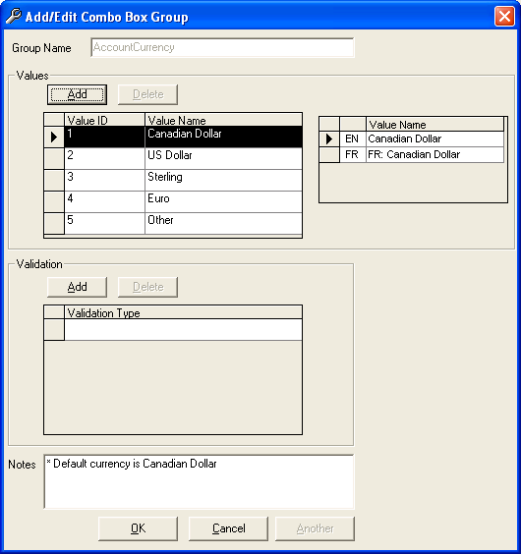
Combo Groups
Combo groups are a list of values obtained from the Omiga database and a value name associated with that value.
The value name is in English and French
The value name:
  Can appear within a combo box in the Omiga GUI, and/or
  Can be used in a rule
The parameters in the function ComboName(GroupName, ValueID) correspond to the values in the fields Group Name and Value ID to return the entry in the Value Name field.
ComboName(AccountCurrency, 2) would return the string
  US Dollar.
Notes:
“Cheating” and discussing some functions early

Slide 12
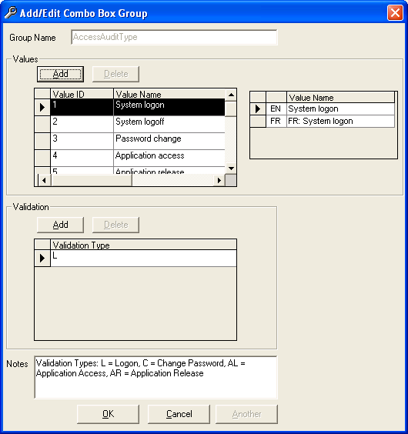
Combo Groups
The parameters in the function IsInComboValidation(GroupName, ValueID, ValType) correspond to the values in the fields Group Name, Value ID, and Value Name. Each Value Name has an optional Validation Type.
This function returns TRUE or FALSE depending upon whether the value of the Validation Type field is the same as those provided in the function parameters.
In the above diagram, the function IsInComboValidation (AccessAuditType, 1, M) would return
  FALSE.
In the above diagram, the function IsInComboValidation (AccessAuditType, 1, L) would return
  TRUE.

Slide 13
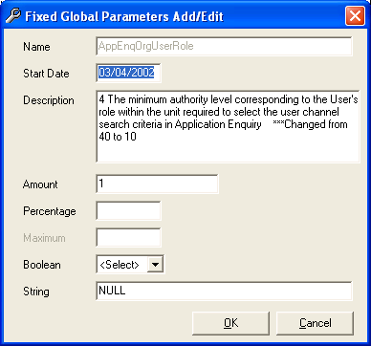
Global Parameters
Global parameters are a set of single values stored in the system. Each global parameter has only one value. This value is stored in one of the following formats:
  Amount
  Percentage
  Boolean
  String
The function GP(Name) returns the value in the field Amount, Percentage, Boolean, or String.
GP(AppEngOrgUserRole) would return
  1 (the value in the Amount field).
Notes:
Maximum field not really supported. If you need to record a range or set of values, use a parameter matrix entry instead.

Slide 14
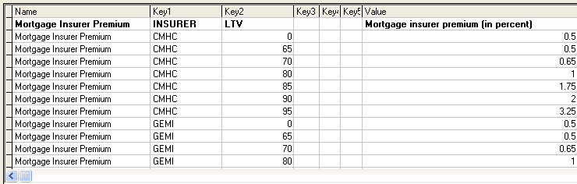
Parameter Matrices and Real-Life Values
Parameter matrices are a useful complex data type if you are working with a set of values that themselves have a range of values.
In this example, each insurer applies an insurer premium to the mortgage. The amount of this premium, in turn, is determined by the Loan-to-Value (LTV) ratio of the mortgage being applied for.

Slide 15
Parameter Matrices
A parameter matrix is made up of a name for a parameter and a set of keys for that parameter. Each key has a unique key value associated with it. Each key value has a value associated with it.
The number of values that can be supported is based on the number of keys.
Note:
  There can never be a parameter matrix where two keys have the same value.
  You can only use standard English alphanumeric characters in the Name, Key, and Description fields.
  You can key French characters into the value field.
Notes:
Basically, can’t use French descriptions in matrix column headers

Slide 16
Parameter Matrices
The function MX(Name, Key1, Key2…) returns the key value corresponding to the parameter matrix with the given Name and values for Key1, Key2, and so on.
The function MXR(Name, Key1, Key2…) returns the last entry in the parameter matrix for the parameter matrix with name of Name where the values of Key1, Key2, and so on entered are less than or equal to the corresponding values in the parameter matrix.

Slide 17
Parameter Matrices
Parameter Matrix Name | Level | Income | Key Value
Risk Factor | 1 | 150000 | 5
Risk Factor | 1 | 75000 | 5
Risk Factor | 1 | 50000 | 10
Risk Factor | 2 | 150000 | 15
Risk Factor | 2 | 75000 | 25
Risk Factor | 3 | 150000 | 20
Risk Factor | 3 | 75000 | 45
Risk Factor | 3 | 50000 | 65
Risk Factor | 4 | 150000 | 25
Risk Factor | 4 | 75000 | 65
Risk Factor | 4 | 50000 | 85
MX(RiskFactor, 3, 75000) would return
  45.
MXR(RiskFactor, 2, 65000) would return
  10. This is the last value in this parameter matrix where both keys in the matrix are less than or equal to the values you entered in the function. (Level of 1 is less than 2, Income of 50000 is less than 65000.).
Notes:
Pause for class responses

Slide 18
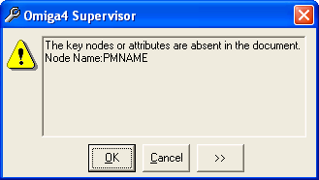
Parameter Matrices: Working With Data
You can export the parameter matrix data to an XML or Excel file
You can import an XML or Excel file into your parameter matrix data
When you import data, Supervisor validates it
Notes:
Data cannot be imported if it fails the validation check

Slide 19
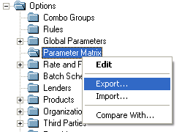
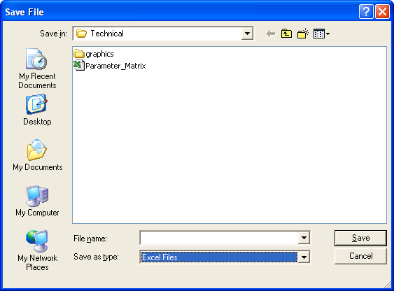
Parameter Matrices: Exporting Data
Right-click on the Parameter Matrix folder.
Choose Export.
Choose XML or Excel as the format.

Slide 20
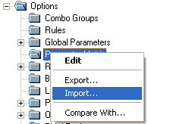
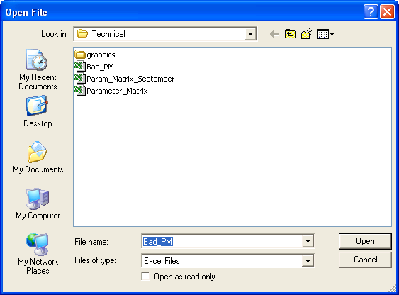
Parameter Matrices: Importing Data
Right-click on the Parameter Matrix folder.
Choose Import.
Choose XML or Excel as the format.

Slide 21
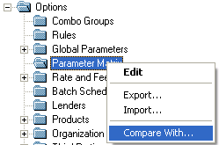
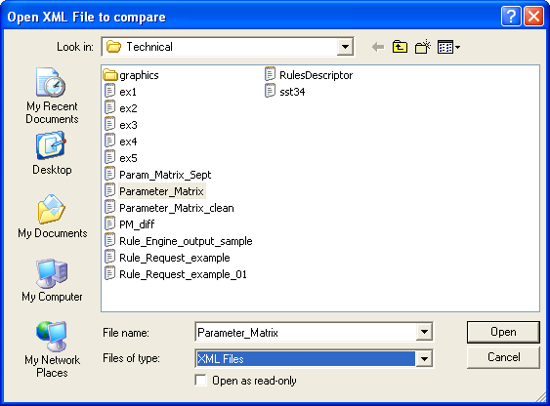
Parameter Matrices: Comparing Data
Right-click on the Parameter Matrix folder.
Choose Compare With.
Choose the file format and filename.

Slide 22
Parameter Matrices: Viewing Differences
Differences are displayed in the system Web browser (Internet Explorer)
Deleted parameter matrix data appears with a minus sign and blue text
Added parameter matrix data appears with a plus sign and green text

Slide 23
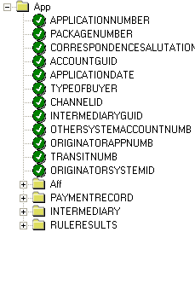
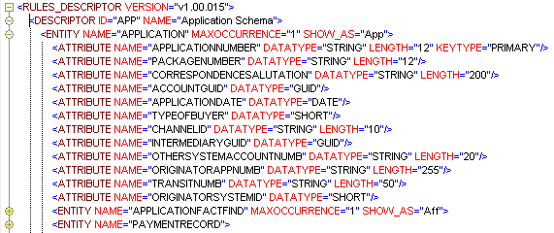
RulesDescriptor.xml
Representation of the internal Omiga schema
Presented in Rules Designer in graphical tree format

Slide 24
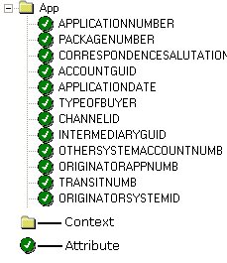
Contexts and Attributes
Contains contexts and attributes
Represent tables and columns inside the Omiga schema
Used to build rules

Slide 25
Rules Designer
Module 3: Rule Elements

Slide 26
Elements of Rules
Rules contain the following elements:
  Rule ID
  Rule Name
  Group Type
  Component Type
  Description
  Context
  Loop (optional)
  Filters (optional)
  Conditions (at least one condition)
  Output (at least one output type)

Slide 27
Elements of Rules
Rule ID is unique identifier for the rule
  Alphanumeric, plus “. - _” separator characters.
Rule Name
  Can be returned as part of the rule output.
  English and French values.
Group Type
  Identifier. Not used by Omiga system. Maintained in RuleType combo group.
Component Type
  Identifier for managing rules based on XML schema descriptor. Maintained in ComponentType combo group.
Description
  Description of the rule.

Slide 28
Rule Elements: Contexts
The Omiga rule descriptor represents the view of the Omiga database for building rules.
The Context pane displays the data existing in the Omiga rule descriptor.
Each rule must have a context. The context for the rule determines what attributes for the rule are available.
Each context contains one or more attributes, as well as potentially containing one or more subcontexts .
The structure of all available contexts and attributes is visible in the tree view on the bottom left of the Rules Designer window.
In the following example diagram, the context APPLICATION and all its attributes and subcontexts are shown.

Slide 29
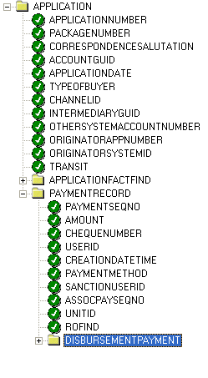
Rule Elements: Contexts
Selecting a context within a rule will affect what other attributes are available for you to use in the filters and conditions for the rule.
For example, in the following rule, the DISBURSEMENTPAYMENT context was selected as the rule Context.

Slide 30
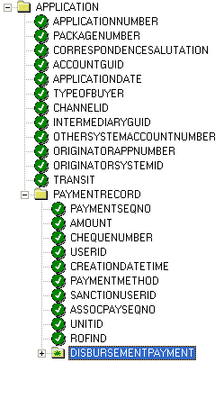
Rule Elements: Contexts
After selecting the DISBURSEMENT context, the APPLICATIONFACTFIND context is no longer available.
Notes:
This is after the drag and drop of the DISBURSEMENT context to the CONTEXT field

Slide 31
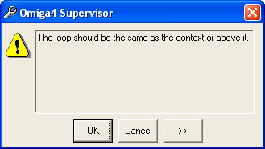
Context Loops
Loops generate multiple outputs for a given condition.
With no loop, a rule will stop processing immediately when the rule evaluates to TRUE or FALSE. There will be a single output from the rule.
If you include a loop with a context, the rule will generate an output for each time the rule evaluates to TRUE.
Loops must be built from either the context itself, or a context directly above it in the tree. If you try and use a context for a loop that does not meet these criteria, the following error message will display.

Slide 32
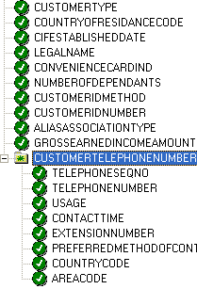
Context Loops: Example
You want to create a rule that finds all customer records that do not have an area code for any of their phone numbers.
If you do not use a loop, any rule you create will only find the first customer record that does not have an area code for a phone number entered.
The customer telephone number information is stored in the context App/Aff/CustomerRole/Customer/CustomerVersion/
CUSTOMERTELEPHONENUMBER.

Slide 33
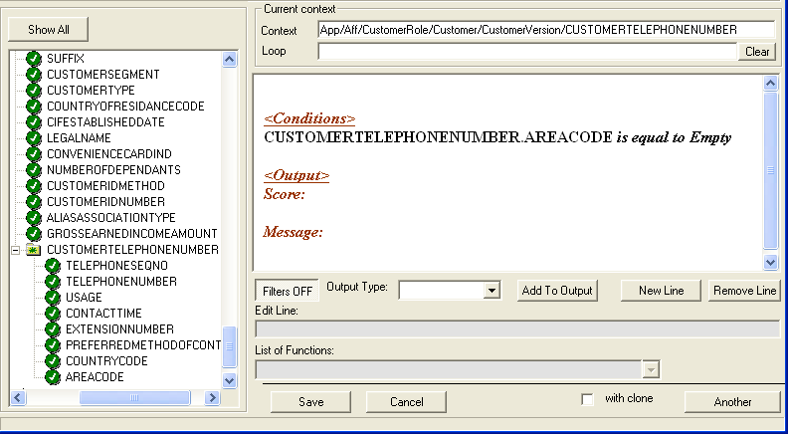
No Loop: First Failure
If no loop is entered, the first customer record with a telephone number without an area code is found, and all further processing of this rule stops

Slide 34
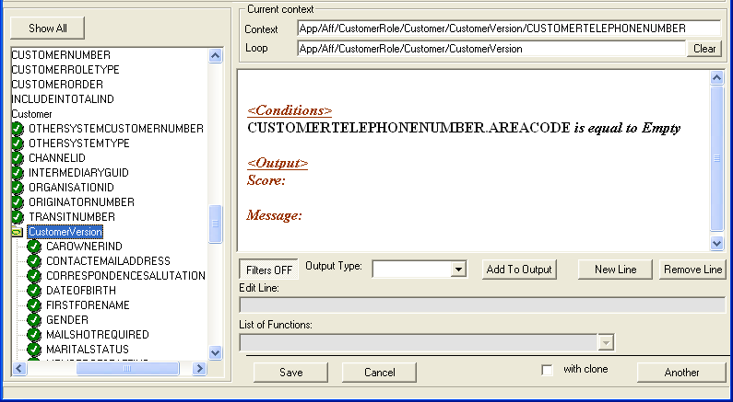
Loop: One Failure per Customer

Slide 35
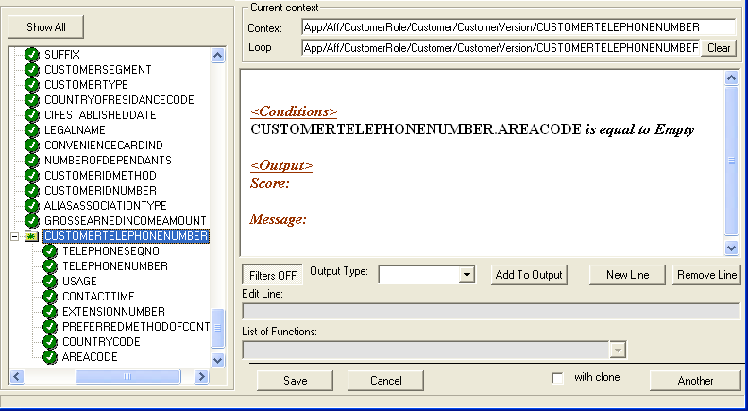
Loop: All Failures, All Customers

Slide 36
Loop: How It Works
Have to consider the structure of the underlying XML file and the data
Customers can have multiple telephone numbers (home, mobile, pager, FAX, work)
As you move down towards a more specific loop for your data, the Rules Engine will process it differently

Slide 37
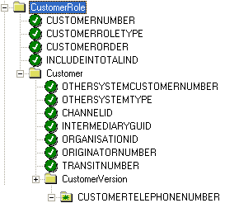
Loop: XML Structure
Two loops were used, CUSTOMERVERSION and CUSTOMERTELEPHONENUMBER
Same context used,
CUSTOMERTELEPHONENUMBER
Rules Engine loops through CUSTOMERVERSION, only finds first telephone number, moves on
Rules Engine loops through CUSTOMERTELEPHONENUMBER, finds all telephone numbers, moves on

Slide 38
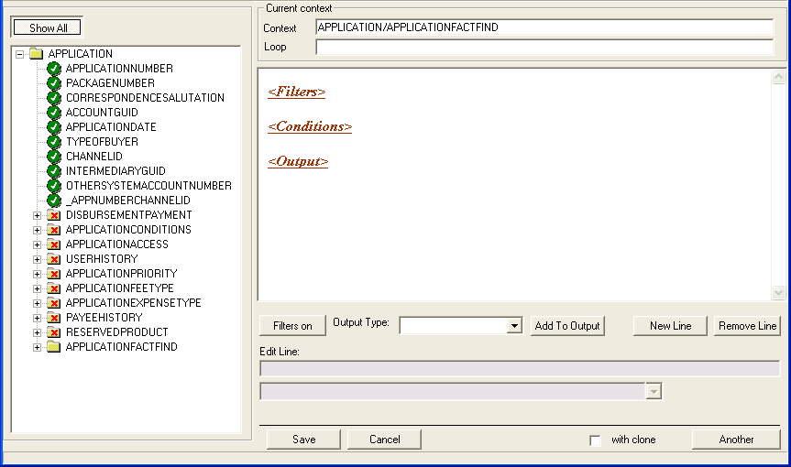
Show All:
Contexts and Attributes
Notes:
Show All with a context defined

Slide 39
Rule Elements: Filters
Filters allow you to pre-process data from Omiga so that you can narrow down the context data being passed to the rule condition(s).

Slide 40
Rule Elements: Conditions
Conditions are used to test context data (after the data has been pre-processed by any filters) and determine what types of output should be generated if the rule evaluates to TRUE.

Slide 41
Rule Elements: Output
Output is the final result of the rule, and is created if the conditions of the rule evaluate to TRUE. Output can take various forms.
Each type of output is treated differently by the system
    As a numeric score
    As a message to the Omiga user
    As the name of the rule
    As an override value
    As a screen ID
    As the mortgage application status
    As the mortgage insurer type

Slide 42
Comparison Criteria
Criteria | Description
Between | Value on left is contained within the group of values on the right, for example APP.TYPEOFBUYER between (1,5). This is TRUE if APP.TYPEOFBUYER is 1, 2, 3, 4 or 5.
is equal to equals to equal to equals equal is = | Value on left is the same as the value on the right, for example APP.TYPEOFBUYER is 10. This is TRUE if APP.TYPEOFBUYER is exactly 10.
greater than or equal to greater or equal greater or = greater = | Value on left is greater than or equal to the value on the right, for example APP.TYPEOFBUYER greater than or equal to 10. This is TRUE if APP.TYPEOFBUYER is APP.TYPEOFBUYER is 10 or greater.
greater than greater | Value on left is greater than the value on the right, for example APP.TYPEOFBUYER greater than 10. This is TRUE if APP.TYPEOFBUYER is 11 or greater.

Slide 43
Comparison Criteria
Criteria | Description
in list in | Value on left is found in the list of values on the right, for example APP.TYPEOFBUYER in list (1,3,5,6). This is TRUE if APP.TYPEOFBUYER is 1, 3, 5 or 6.
less than or equal to less or equal less or = less = | Value on left is less than or equal to the value on the right, for example APP.TYPEOFBUYER less than or equal to 10. This is TRUE if APP.TYPEOFBUYER is a number from 1-10.
less than less | Value on left is less than the value on the right, for example APP.TYPEOFBUYER less than 10. This is TRUE if APP.TYPEOFBUYER is a number from 1-9.
is not equal to not equals to not equal to not equals not equal is not | Value on left is not the same as the value on the right, for example APP.TYPEOFBUYER not equal to 10. This is TRUE if APP.TYPEOFBUYER is any value but 10.

Slide 44
Comparison Syntax
You can enter the following types of parameters into a comparison.
  When you enter a list, use round brackets to enclose the list.
  Alphabetic List: Any list of contiguous or non-contiguous letters separated by commas.
    To enter all letters from a to g as a parameter, you would enter (a,b,c,d,e,f,g).
  Date: Dates are entered in the format DD/MM/YYYY.
    For example, August 15, 2003 would be entered as DD/MM/YYYY.
    Ensure that the date format is used consistently!
  Number: Any number with up to 7 decimal places.

Slide 45
Comparison Syntax
  Numeric List: Any list of contiguous or non-contiguous numbers. To enter a contiguous list of numbers from 1 to 10 as a parameter, you would enter (1,2,3,4,5,6,7,8,9,10). To enter all even numbers less than or equal to 10, you would enter (2,4,6,8,10).
  String: Any combination of letters and numbers, for example A390-PO11.
  Function: Any of the functions described later can be used as a value for comparison.

Slide 46
Matching Comparison Value Types
It is important to match the same kind of value (number/number, string/string, and so on) on both sides of the comparison being done
Not doing this can lead to errors in the rules when they are being evaluated

Slide 47
Rules Designer
Module 4: Rule Construction

Slide 48

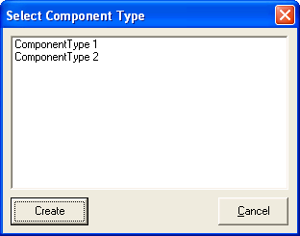
Initialize a New Rule
In the main Supervisor window, right-click on the Rules folder and select Add New.
Select Component Type appears.
Click on the component type you want to use with the rule and click Create.
Omiga 4 – Rule Designer appears.

Slide 49
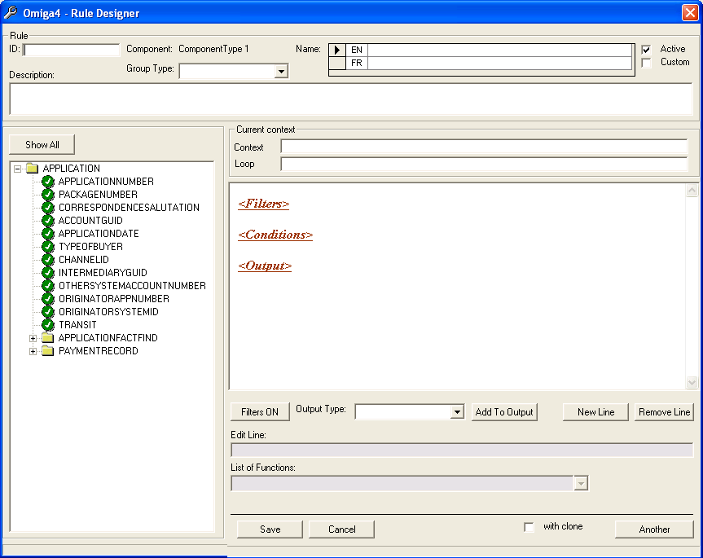
Initialize a New Rule
Enter the Rule ID you want to use with this rule.
Select the Group Type from the drop-down list.
Enter a Name for this rule. If you are creating a rule in both English and French languages:
  Enter the English Name in EN.
  Enter the French Name in FR.
Enter a brief Description for this rule.
Click on a context in the left hand tree list and move it to the Context field using a drag-and-drop operation.

Slide 50
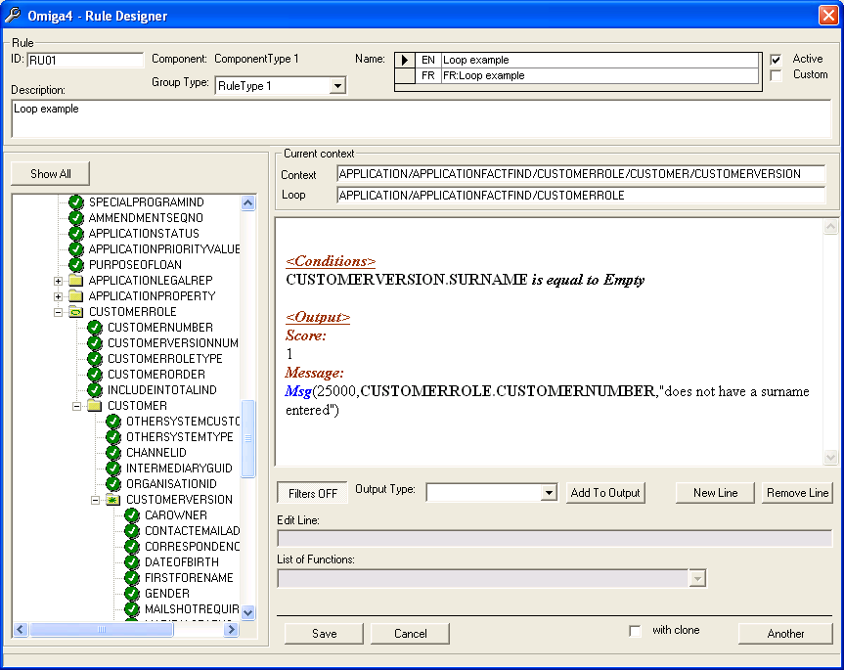
Initialize a New Rule
To add a loop for this rule, click on a context in the left hand tree list and move it to the Loop field using a drag-and-drop operation.
The rule is now initialized, and you can now add any filters, conditions, and outputs to the rule.
“Active” enables the rule for processing
“Custom” executes an external DLL to perform the rule processing.
After you have finished working with the rule, click Save.
Rule Designer closes and the rule is saved.

Slide 51
Add Filters to a Rule
After initializing a rule, you can add filters to it.
Filters are used to pre-process data from Omiga before any conditions are applied to the data.
Use a filter to select a subset of data from Omiga. If the comparison from the filter is TRUE, the rule will continue processing.
This subset of data is analyzed using the conditions you add to the rule.

Slide 52
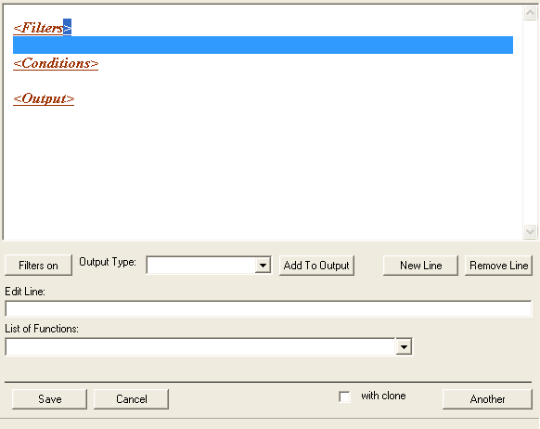
Add Filters to a Rule
Place the mouse cursor below the line reading <Filters> and double-click.
The screen below the line reading <Filters> changes colour and the Edit Line field is activated.

Slide 53
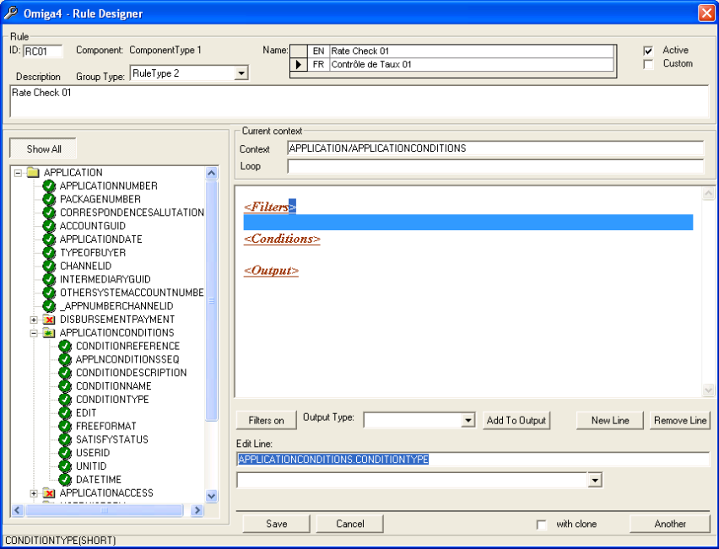
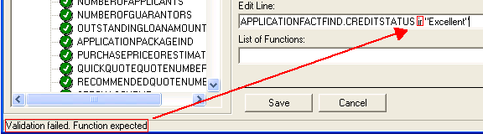
Add Filters to a Rule
Enter the filter criteria you want to use.
  use a drag and drop operation to add items from the tree list
  or type in criteria directly
Add comparison criteria to the filter.
Press the Enter key. The filter is validated by the Rules Wizard. If there is a problem, there will be a notification in the status bar.
  In this case, the comparison is was misspelled as ir.
If the filter validates successfully, it appears in the main window.

Slide 54
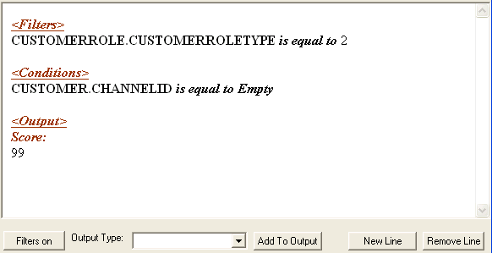
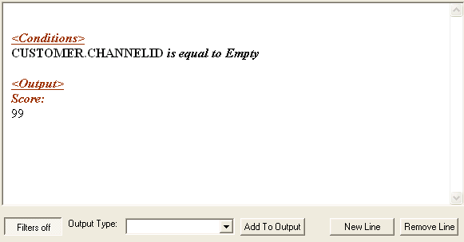
Turn Filters On and Off
You can turn all filters in a rule on or off without needing to delete the corresponding filter lines.
Note: You cannot selectively turn individual filter lines on or off. Either all filters are off, or all filters are on.
Double-click on the desired rule.
If Filters on is visible, all filters in the rule are available.

Slide 55
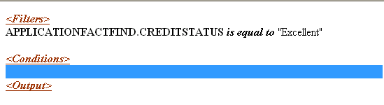
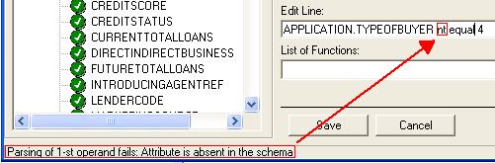

Add Conditions to a Rule
Place the mouse cursor below the line reading <Conditions> and double-click.
The screen below the line reading
<Conditions> changes colour and the Edit Line field is activated.
In Edit Line, enter the condition criteria you want to use. You can use a drag and drop operation to add items from the tree list on the left, or type in criteria directly.
Add whatever comparison criteria you want to the condition.
Press the Enter key. The condition is validated by the Rules Wizard. If there is a problem, there will be a notification in the status bar.
If the condition validates successfully, it appears in the main window

Slide 56
Filter and Condition Groups
You can group sets of filters or conditions together by using the keyword OR when you are adding filters or conditions. The keyword OR separates filters or conditions into groups. When the rule evaluates a filter or condition, it evaluates each group separately. All groups must return FALSE for the filter or condition to evaluate as FALSE.
If a filter or set of filter groups is evaluated as FALSE, the rule stops evaluating. If a condition or set of condition groups is evaluated as FALSE, the rule does not generate the output associated with that rule. The rule will return a value of 0 (zero).
Important: The exception to this is when you use the NotExist function in a condition group. This function will stop all further processing of the rule if it evaluates to TRUE, no matter how many other condition groups remain to be evaluate. You can only use this function in condition groups.

Slide 57
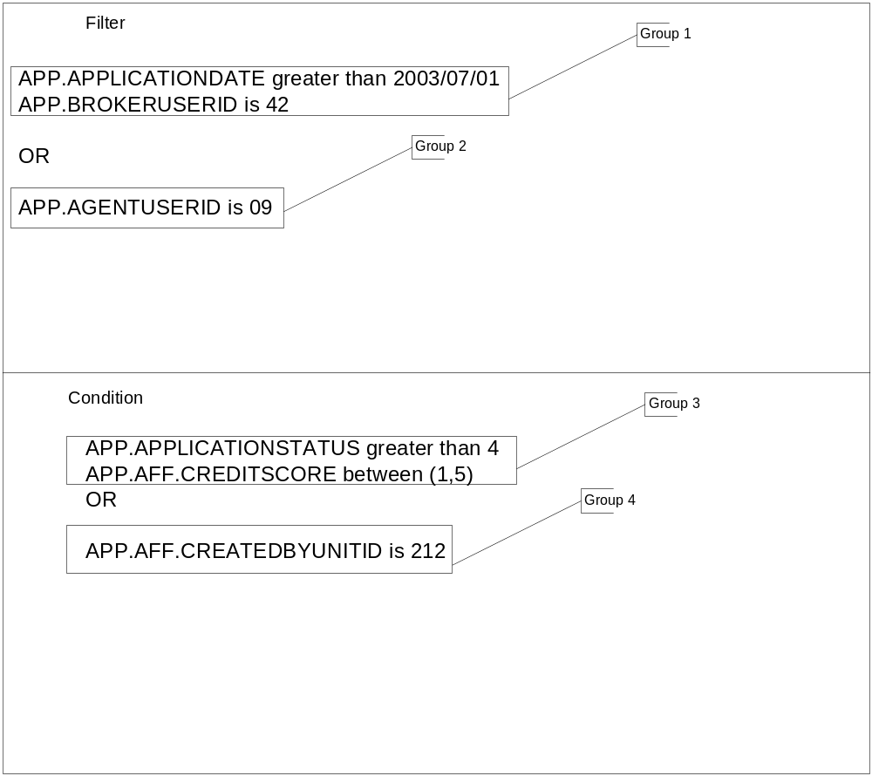
Filter and Condition Groups Example

Slide 58
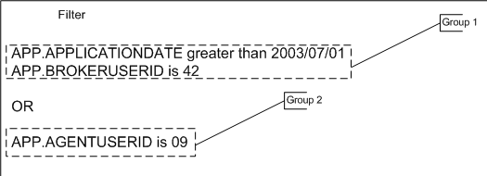
Filter Group Processing
Group | Result of Evaluation by Rule
1 | If APP.APPLICATIONDATE is after June 1, 2003 and APP.BROKERUSERID is 42, then the first group evaluates as TRUE. Otherwise, it evaluates as FALSE. Since the keyword OR is present, the rule evaluates the next filter group before all filters evaluate as TRUE or FALSE.
2 | If APP.AGENTUSERID is 09, then the second group evaluates as TRUE. Otherwise, it evaluates as FALSE. This is the last filter group in the list, so the rule looks at the evaluation results from all filter groups.
If both are TRUE, the filter evaluates as TRUE, and the rule is processed further.
If only one is TRUE, the filter evaluates as TRUE, and the rule is processed further.
If both are FALSE, the filter evaluates as FALSE, and the rule is not processed further. Condition groups 3 and 4 are ignored, and no output from the rule is created.
Notes:
For the purposes of this presentation, we make it through the filter groups

Slide 59
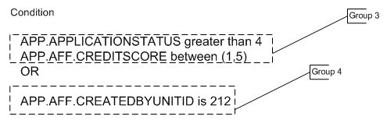
Condition Groups
Group | Result of Evaluation by Rule
3 | If APP.APPLICATIONSTATUS is greater than 4 and APP.AFF.CREDITSCORE is equal to 1, 2, 3, 4, or 5 then the first group evaluates as TRUE. Otherwise, it evaluates as FALSE. Since the keyword OR is present, the rule evaluates the next condition group before all conditions evaluate as TRUE or FALSE.
4 | If APP.AFF.CREATEDBYUNITID is 212, then the second group evaluates as TRUE. Otherwise, it evaluates as FALSE. This is the last condition group in the list, so the rule looks at the evaluation results from all condition groups.
If both are TRUE, the condition evaluates as TRUE, and the rule creates the output you have built in the rule. (See Understanding Rule Outputs on page 28.)
If only one is TRUE, the condition evaluates as TRUE, and the rule creates the output you have built in the rule.
If both are FALSE, the condition evaluates as FALSE, and the rule does not create the output you have built in the rule. It returns a value of 0 (zero).

Slide 60
Create a Filter or Condition Group
Double-click on the filter or condition below which you want to add the keyword OR.
In Edit Line, type OR and press the Enter key.
The keyword OR is added below the filter or condition.
You can create as many groups as required.

Slide 61
Understanding Functions
Functions are used in the Rules Wizard of Supervisor to process data internally as part of a filter, condition, or output.
Function | Parameters | Description
ComboName (GroupName, ValueID) | GroupName: The name of the combo group as obtained from the Combo Groups folder of Supervisor. ValueID: The value ID of the value you want to retrieve from the combo group with the given GroupName. | Retrieves the value name corresponding to the GroupName and ValueID.
DayOfMonth(Date) | Date: A date in DD/MM/YYYY format (for example, 15/03/2002). | Returns a number corresponding to the day of the month (from 1 to 31).
DayOfWeek(Date) | Date: A date in DD/MM/YYYY format (for example, 15/03/2002). | Returns a number corresponding to the day of the week. 0: Sunday 1: Monday 2: Tuesday 3: Wednesday 4: Thursday 5: Friday 6: Saturday

Slide 62
Understanding Functions
Function | Parameters | Description
DiffInYears(Date1, Date2) | Date1, Date2: Two dates in DD/MM/YYYY format (for example, 15/03/2002). | Subtracts Date1 from Date2 and returns the result, rounded down to years.
GP(Name) | Name: The name of the global parameter as obtained from the Global Parameters folder of Supervisor. | Retrieves the value from the Global Parameters folder of Supervisor with the given Name.
IsInComboValidation (GroupName, ValueID, ValType) | GroupName: The name of the combo group as obtained from the Combo Groups folder of Supervisor. ValueID: The value ID of the value you want to retrieve from the combo group with the given GroupName. ValType: The validation type you want to test for. | Checks if ValType is in the validation list for the combo group corresponding to GroupName and ValueID.
Msg(ErrMsg, Param1, Param2,…) | ErrMsg: The error message number as obtained from the Error Messages folder of Supervisor. Param1, Param2,…: Parameters. | Retrieve the message from the Error Messages folder of Supervisor corresponding to the ErrMsg parameter.

Slide 63
Understanding Functions
Function | Parameters | Description
MX(Name, Key1, Key2…) | Name: The name of the parameter matrix as obtained from the Parameter Matrix folder of Supervisor. Key1, Key2,…: The corresponding keys from the parameter matrix entry with the given Name. | Retrieves the value from the Parameter Matrix folder of Supervisor with the given Name and Key values.
MXR(Name, Key1, Key2…) | Name: The name of the parameter matrix as obtained from the Parameter Matrix folder of Supervisor. Key1, Key2,…: The corresponding keys from the parameter matrix entry with the given Name. | Like the MX function. Looks at the values for each Key you have entered and finds the last parameter matrix entry where all key values are less than or equal to the corresponding Key1, Key2,… you entered, and returns the key value for that record entry. Useful when passing values in the function that are not exactly the same as those contained in the parameter matrix.

Slide 64
Understanding Functions
Function | Parameters | Description
NotExist(ContextName) | ContextName: Name of an available context. | Important: This function can be used in the condition section only, not in the filter section. The whole rule fails if: o The context with ContextName does not exist o The context with ContextName exists, but does not contain any attributes or subcontexts. If this function is used, it must be the only item in its condition group. For example, Context: CUSTOMERADDRESS Loop: CUSTOMER Filter: CUSTOMERADDRESS.ADDRESSTYPE = 1 (Home) Condition: NotExist() This rule will fail for each customer where the Home address is missing.
Now() | None. | Returns the current system date.

Slide 65
Understanding Functions
Function | Parameters | Description
PrevValue(Attribute) | Any attribute. | Returns the previous value as stored in the system for the given attribute. For example, an amendment is received in the system, and you want to compare the amendment value for the attribute TOTALLOANAMOUNT to the same attribute in the original mortgage application. Using PrevValue will return the value as found in the original mortgage application.
RuleScore() | None. | Returns the score from the previous rule.

Slide 66
Understanding Functions
Function | Parameters | Description
DiffInMonths(Date1, Date2) | Date1, Date2: Two dates in DD/MM/YYYY format (for example, 15/03/2002). | Subtracts Date1 from Date2 and returns the result, rounded down to months.
Left(String, Length) | String: Any string. Length: Any positive integer. | Returns Length characters of String starting from the left (beginning) of the string. If Length is greater than the length of String, the whole String is returned.

Slide 67
Understanding Functions
Function | Parameters | Description
Max(Value1, Value2) | Value1, Value2: Any two values of the same type. | Returns the larger of the two values supplied.
Mid(String, Position, Length) | String: Any string. Position: The point in the string where the function begins. The first character in the string corresponds to position 1. Length: Any positive integer. | Returns Length characters of String, starting from Position in this string. If Length is greater than the length of the String, the rest of the String starting at Position is returned. If Position is less than 1, 1 is assumed. If Position is greater than the String length, an empty value is returned.
Min(Value1, Value2) | Value1, Value2: Any two values of the same type. | Returns the smaller of the two values supplied.

Slide 68
Understanding Functions
Function | Parameters | Description
Right (String, Length) | String: Any string. Length: Any positive integer. | Returns Length characters of String starting from the right (end) of the string. If Length is greater than the length of String, the whole String is returned.
RuleName() | None. | Returns the current Rule Name.
StartWith (Source_String, Find_String) | Source_String: The string in which you want to search for text. Find_String: The string containing the text you want to search for in Source_String. | If Source_String begins with Find_String, this function returns TRUE. Otherwise, it returns FALSE. If Source_String or Find_String is empty, this function returns FALSE.

Slide 69
Understanding Rule Outputs
After all conditions for a rule have been examined, the rule creates one or more outputs. If the rule evaluates to FALSE, the output of the rule is always zero. If the rule evaluates to TRUE, the output of the rule is the output you define in the Output section of the rule.
The output is flexible and can be created in any of the following formats:
    As a numeric score
    As a message to the Omiga user
    As the name of the rule
    As an override value
    As a screen ID
    As the mortgage application status
    As the mortgage insurer type
You can have multiple outputs in your rule, using any of the above formats. There is no limit to the number of outputs you can have in a rule. Output can be constructed using any of the available attributes in your current context. Like filters and conditions, you can add functions to further customize the output.

Slide 70
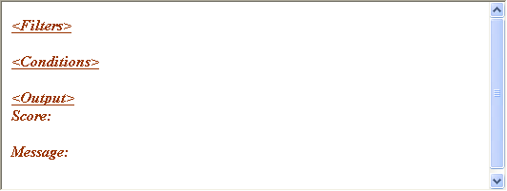
Default Rule Outputs
When you create a new rule, you choose a component type.
Each component type has a default output associated with it.
For example, depending on configuration, if you choose an automatic adjudication component type, you will have the following default output types:

Slide 71


Create Scored Output
Double-click the line below Score: in the rule.
In Edit Line, enter the score you want to assign to this rule’s output.
Press the Enter key.
The score is added to the rule output.

Slide 72

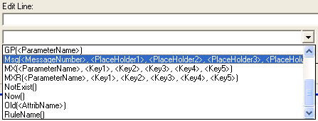


Create Message Output
Double-click the line below Message: in the rule.
Click on the drop-down box below Edit Line.
Move the mouse cursor over the Msg function, and move the function to Edit Line with a drag-and-drop operation.
In Edit Line, enter the MessageNumber and any parameters for this message. The MessageNumber is the number of an error message built using Supervisor.
Press the Enter key.
The message is added to the rule output.

Slide 73


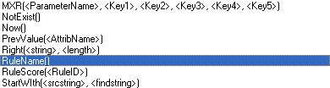

Create This Rule Name Output
Select This Rule Name from the Output Type drop-down list.
Click Add to Output. The rule changes to display the output type.
Double-click the line below This Rule Name: in the rule.
From List of Functions, choose the RuleName() function.
Press the Enter key. This Rule Name is added to the rule output.

Slide 74


Create Override Value Output
Select Override Value from the Output Type drop-down list.
Click Add to Output.
The rule changes to display the output type.
Double-click the line below Override Value: in the rule.
In Edit Line, enter the override value you want to assign to this rule’s output.
Press the Enter key.
The override value is added to the rule output.0.

Slide 75


Create Screen ID Output
Select ScreenID from the Output Type drop-down list.
Click Add to Output.
The rule changes to display the output type.
Double-click the line below ScreenID: in the rule.
In Edit Line, enter the score you want to assign to this rule’s output.
Press the Enter key.
The screen ID is added to the rule output.

Slide 76

Create Application Status Output
Select Application Status from the Output Type drop-down list.
Click Add to Output.
The rule changes to display the output type.
Double-click the line below Application Status: in the rule.
In Edit Line, enter the application status you want to assign to this rule’s output.
Press the Enter key.
The application status is added to the rule output.

Slide 77
Create Mortgage Insurer Type Output
Select Mortgage Insurer Type from the Output Type drop-down list.
Click Add to Output.
The rule changes to display the output type.
Double-click the line below Mortgage Insurer Type: in the rule.
In Edit Line, enter the Mortgage Insurer Type you want to assign to this rule’s output.
Press the Enter key.
The mortgage insurer type is added to the rule output.

Slide 78

French Characters
Omiga 4 allows you to work with mortgage applications in English and French. When entering rules into Supervisor, you can enter a French translation in the Rule Name field:
To enter French accented letters (like é - accent aigu, è - accent grave, ê - accent circonflexe, ë - accent tréma, or a ç - cédille), you can either use the Windows Character Map or enter letters directly using the Alt-key and the number keypad.
Notes:
French keyboard also should work – preliminary tests with remapping US keyboard using French as the system language seemed to work OK

Slide 79
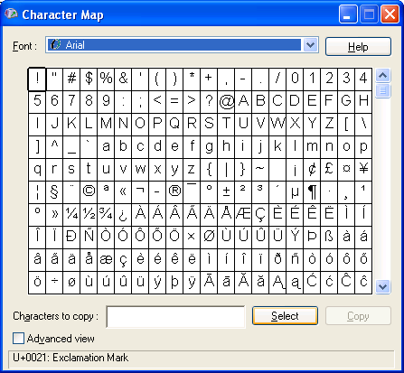
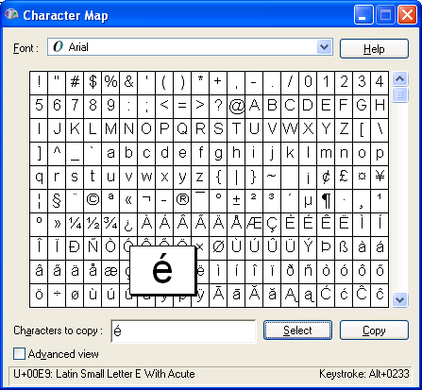
French Characters
Select Start > Programs > Accessories > Character Map. Character Map appears.
Click on the accented letter you want to insert, then click Select. The letter you chose is displayed in Characters to copy.
Repeat step 2 for as many letters as you want to copy to Supervisor. When you have finished selecting letters, click Copy.
The selected letters are copied to the system clipboard, and can be pasted into Supervisor using Ctrl-V.

Slide 80
French Characters
You can use the Alt-key and the numeric keypad to enter French-accented letters directly into Supervisor.
Note: Not all fonts support the French alphabet.
If the Num Lock light is not on, press Num Lock on your keyboard and ensure the Num Lock light turns on.
Hold down the Alt-key.
On the numeric keypad, press the numbers in succession that match the letter you want to enter. The following table summarizes the accented character and the key sequence. For example, to enter é, you would hold the Alt-key and enter the number sequence 130.
Release the last number, then release the Alt-key.
The accented character is inserted into Supervisor.

Slide 81
French Characters
Accented Character
Alt-Key Sequence
Accented Character
Alt-Key Sequence
à
Alt+133
Ä
Alt+142
À
Alt+0192
ä
Alt+132
â
Alt+131
ç
Alt+135
Â
Alt+0194
Ç
Alt+128
é
Alt+130
œ
Alt+0156
É
Alt+144
Œ
Alt+0140
ê
Alt+136
ù
Alt+151
Ê
Alt+0202
Ù
Alt+0217
è
Alt+138
û
Alt+150
È
Alt+0200
Û
Alt+0219
ë
Alt+137
ü
Alt+129
Ë
Alt+0203
Ü
Alt+154
î
Alt+140
ÿ
Alt+0255
Î
Alt+0206
Ÿ
Alt+0159
ï
Alt+139
«
Alt+0171
Ï
Alt+0207
»
Alt+0187
ô
Alt+147
€
Alt+0128
Ô
Alt+0212
Notes:
Just for reference only, not going to spend a lot of time on this

Slide 82
Rules Designer
Module 6: Working With Existing Rules

Slide 83

Edit Existing Rule
Click on the Rules folder.
Double-click on the rule you want to edit.
The rule opens.
To add a new line below an existing line, click on the existing line, then click New Line. Enter the new text in Edit Line, then press Enter.
To edit an existing line, double-click on the line and change the text in Edit Line, then press Enter.
To delete an existing line, click on the line and then click on Remove Line.
Notes:
If you change the Rule ID, you get a warning message

Slide 84
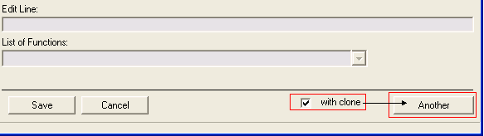

Clone Existing Rule
Create a rule.
Select with clone.
Click Another. A new rule opens with the same parameters as the original rule. Make any changes you want in this rule before saving it.
- or -
Right-click on an existing rule and select Clone.
Note: Never assign an existing Rule ID to a cloned rule.
Notes:
Allows you to template a set of rules

Slide 85

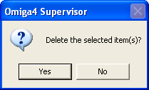
Delete Existing Rule
Right-click on an existing rule in the Supervisor main window and select Delete.
A dialog box appears asking you to confirm your choice. Click Yes.
The rule is deleted.

Slide 86
Rules Designer
Module 7: Configuration Examples

Slide 87
MX Example
The following example shows how a parameter matrix entry can be used to provide data for a rule using the MX function
<Filters> MSQ.INSUREDIND is equal to False
Quotation.QUOTATIONNUMBER is equal to Aff.ACCEPTEDQUOTENUMBER
INDEMNITYINSURANCE.INSURERTYPE is equal to 20
MSQ.LTV greater than GP(CIBC_RISK_GEMI_LTV)
Mid(MortgageInsurer.PROPERTYRISKRATING,2,1) is equal to M
Mid(MortgageInsurer.MARKETINGRISKRATING,3,1) is equal to H
<Conditions> IsInComboValidation(PurposeOfLoan,Aff.PURPOSEOFLOAN,Refinance) is equal to true
<Output>
Score: 1
Message: Msg(MX(Risk Loan Output15,Aff.RESPONSIBLEREGION))

Slide 88
MX Example (cont’d)
<PMNAME NAME="Risk Loan Output15" T1="Aff.RESPONSIBLEREGION" T2="Key2" T3="Key3" T4="Key4" T5="Key5" DESC="Determine valid message to Underwriter for risk loans based on region">
<PMVALUE NAME="Risk Loan Output15" K1="10" V="30047"/>
<PMVALUE NAME="Risk Loan Output15" K1="20" V="30047"/>
<PMVALUE NAME="Risk Loan Output15" K1="50" V="30047"/>
<PMVALUE NAME="Risk Loan Output15" K1="150" V="30047"/>
<PMVALUE NAME="Risk Loan Output15" K1="60" V="30047"/>
<PMVALUE NAME="Risk Loan Output15" K1="140" V="30047"/>
</PMNAME>

Slide 89
MXR Example
The following example shows how a parameter matrix entry can be used to provide data for a rule using the MXR function
<Filters>
MSQ.INSUREDIND is equal to False
INDEMNITYINSURANCE.INSURERTYPE is equal to 20
<Conditions> MXR(CIBC_POSTAL_CODE_MAX_PURCHASE_PRICE,Left(PropertyAddress.POSTCODE,3),NewProperty.ORIGINALPURCHASEPRICE) is equal to FALSE
OR
MXR(CIBC_ABCPOSTAL_CODE_MAX_PURCHASE_PRICE,Left(PropertyAddress.
POSTCODE,1),NewProperty.ORIGINALPURCHASEPRICE) is equal to FALSE
<Output>
Score: 1
Message: Msg(30019)

Slide 90
MXR Example (cont’d)
<PMNAME NAME="CIBC_POSTAL_CODE_MAX_PURCHASE_PRICE" T1="Property Postal Code" T2="Property Purchase Amount" T3="Key3" T4="Key4" T5="Key5" DESC="CIBC Rules - Determination of valid property purchase amounts based on postal codes. For CIBC postal codes E to Z. Refer to CIBC_ABCPOSTAL_CODE_MAX_PURCHASE_PRICE for postal codes beginning with A, B or C">
<PMVALUE NAME="CIBC_POSTAL_CODE_MAX_PURCHASE_PRICE" K1="E0A" K2="0" V="0"/>
<PMVALUE NAME="CIBC_POSTAL_CODE_MAX_PURCHASE_PRICE" K1="E0A" K2="50000" V="1"/>
<PMVALUE NAME="CIBC_POSTAL_CODE_MAX_PURCHASE_PRICE" K1="E0B" K2="200000" V="0"/>
<PMVALUE NAME="CIBC_POSTAL_CODE_MAX_PURCHASE_PRICE" K1="E0A" K2="200000" V="0"/>
<PMVALUE NAME="CIBC_POSTAL_CODE_MAX_PURCHASE_PRICE" K1="E0B" K2="50000" V="1"/>
…
CIBC_ABCPOSTAL_CODE_MAX_PURCHASE_PRICE is similar in structure but applies to postal codes beginning with A, B or C

Slide 91
Rules Designer
Module 8: Configuring Rule Order in the Parameter Matrix

Slide 92
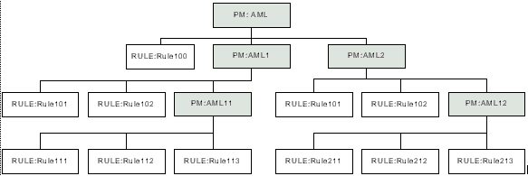
Traversing Rules
Categories are evaluated using the following logic:
The tree is traversed, with each entry being evaluated in the order defined by the sequence number

Slide 93
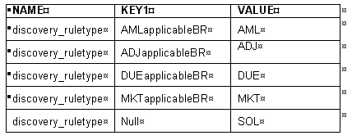
Discovery Mode
A parameter matrix entry with the name discovery_ruletype has been created.

Slide 94
Applicability Categories
Each of the KEY1 values in this parameter matrix correspond to the applicability category. They are found in a different parameter matrix entry, with the name of that parameter matrix entry being the same as the KEY1 value. The Rules Manager will pass along the name of this applicability category to the Rules Engine, which in turn will evaluate all the rules and categories found there.
If any of those rules return a score of 1, then the entry in VALUE will be passed to the Rules Engine. This entry represents the rules for the applicability category represented in KEY1. The exception is if KEY1 is an empty value. In this case, the entry in VALUE will always be passed to the Rules Engine for further processing. In the above example, SOL will always be passed to the Rules Engine, so the set of rules contained in the parameter matrix SOL will always be processed by the Rules Engine.

Slide 95
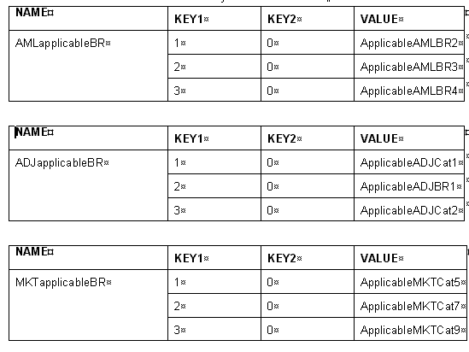
Discovery Mode Matrix
Discovery mode matrix can contain both rules and rule categories

Slide 96
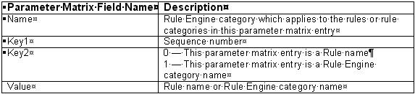

Rule Categories
Grouping of related rules

Slide 97
Rules Designer
Module 9: Configuring Custom Rules

Slide 98
Custom Rules
In addition to rules created in the Rule Designer, you can create custom rules by creating a new COM+ component and adding the rule to it. The syntax for custom rules in Visual Basic 6.0 for a rule with an ID of AA001 is:
    Select Case strRuleID
    Case "AA001": RunRuleAA001 vxmlRequestNode, vxmlResponseNode
After compiling the DLL, the name of the DLL and the rules group it belongs to must be entered in the parameter matrix.
Custom rules can be run either during ingestion or during auto-adjudication. All custom rules must be entered in a parameter matrix entry titled pmUserRules. The COMPONENTTYPE key determines which service will run this rule.

Slide 99
Custom Rule Parameter Matrix
pmUserRules | COMPONENTTYPE | COMPONENTNAME
pmUserRules | 1 | omAARules.AARulesCustomBO
pmUserRules | 2 | omCompRules.CCRulesCustomBO

Slide 100
In What Order Are Rules Run?
Not in order as entered in Rule Designer
Two levels of ordering:
  Base level is in Parameter Matrix
  Secondary level is by Omiga service

Slide 101
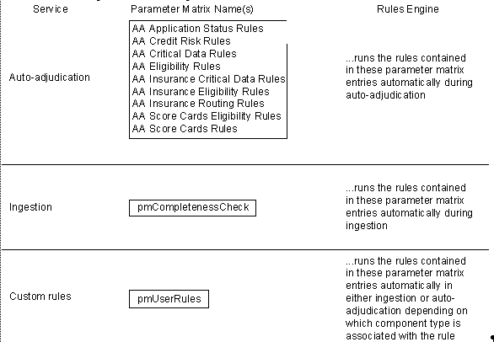
Rules and When They Are Run: Parameter Matrix
The parameter matrix is used to define which rules or groups of rules will be run by various Omiga services

Slide 102
Rules Designer
Exercises

Slide 103

Exercises
Given a business scenario, construct a rule
Examine sample Visual Basic code and construct your own Visual Basic code
Notes:
Different people should name their rules differently, e.g. CC01.1, CC02.2, and so on

